Slide 1
HCL “Share A Legacy Of Excellence”
HCL , the organisation that virtually pioneered the IT revolution in India, is today an established global IT enterprise, with:
Founded on August 11, 1976 by Shiv Nadar
95,000 professionals of diverse nationalities
Holds revenue around US$6.1 billion
Operations in 31 countries of the world
Global partnerships with several Fortune 1000 firms
Significant presence across a spectrum of IT domians

Slide 2
HCL(CDC) “A Division Of HCL INFOSYSTEMS”
As the training arm of HCL Infosystems, HCL Career Development Centre (CDC) carries forth a legacy of excellence spanning across more than three decades. HCL CDC is an initiative that enables individuals and organisations to benefit from HCL's deep expertise in the IT space.
Among the fastest growing IT education brands in India, HCL CDC offers a complete spectrum of quality training programs on software, hardware, networking as well as global certifications in association with leading IT organisations worldwide.

Slide 3
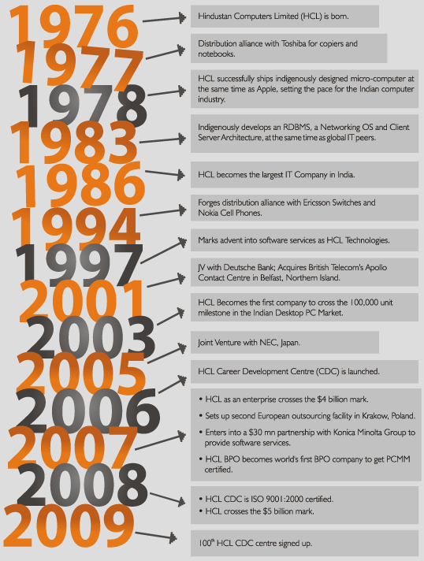

Slide 4


Slide 5

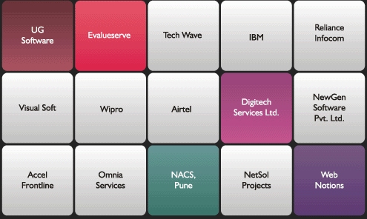

Slide 6


Slide 7
Servlets

Slide 8
What are Servlets?
Units of Java code that run server-side.
Run in containers -A servlet container is a compiled, executable program. The main function of the container is to load, initialize and execute servlets.
Helps with client-server communications.

Slide 9
Why are Servlets?
Used in Web pages with dynamic content
Containers support many features
Sessions, resource management (e.g., database connections), security, etc.

Slide 10
A servlet’s life cycle
The life cycle of a servlet is determined by three methods:
The init () method – initializes the servlet.
The service () method – allows the servlet to respond to a request.
The destroy () method – after calling this method container is shut down and service method is not called again.

Slide 11
Java server Pages(JSP)

Slide 12
The Need for JSP
• With servlets, it is easy to
– Read form data
– Read HTTP request headers
– Set HTTP status codes and response headers
– Use session tracking
– Share data among servlets
– Remember data between requests
– Get fun, high-paying jobs
• But, it sure is a pain to
– Use those println statements to generate HTML
– Maintain that HTML

Slide 13
Benefits of JSP
• Although JSP technically can’t do anything
servlets can’t do, JSP makes it easier to:
– Write HTML
– Read and maintain the HTML
• JSP makes it possible to:
– Use standard HTML tools such as DreamWeaver
– Have different members of your team do the HTML layout than do the Java programming
• JSP encourages you to
– Separate the (Java) code that creates the content from the (HTML) code that presents it

Slide 14
JSP Scripting Elements
Declarations
Are inserted outside any methods (in the body) of the servlet
Example: <%! private int counter; %>
Expressions
Are evaluated and inserted into the output
Example: <%= poll.getAnswer() %>
Scriptlets
Java code, which is inserted into the servlet
Example: <% for( int i=0; i<poll.getAnswerCount(); i++ ) %>

Slide 15
Ten Most Popular Web Sites
(Alexa.com, 2011)
Google - Java (Web), C++ (indexing)
Facebook -PHP
Youtube -Flash, Python, Java
Yahoo -PHP, Java
Microsoft Live.com -.NET
Baidu -UNKNOWN
Wikipedia -PHP
Blogger -Java
MSN -.NET
Twitter -Ruby on Rails, Scala, Java

Slide 16
Project snapshots: (ONLINE RESUME MART)

Slide 17
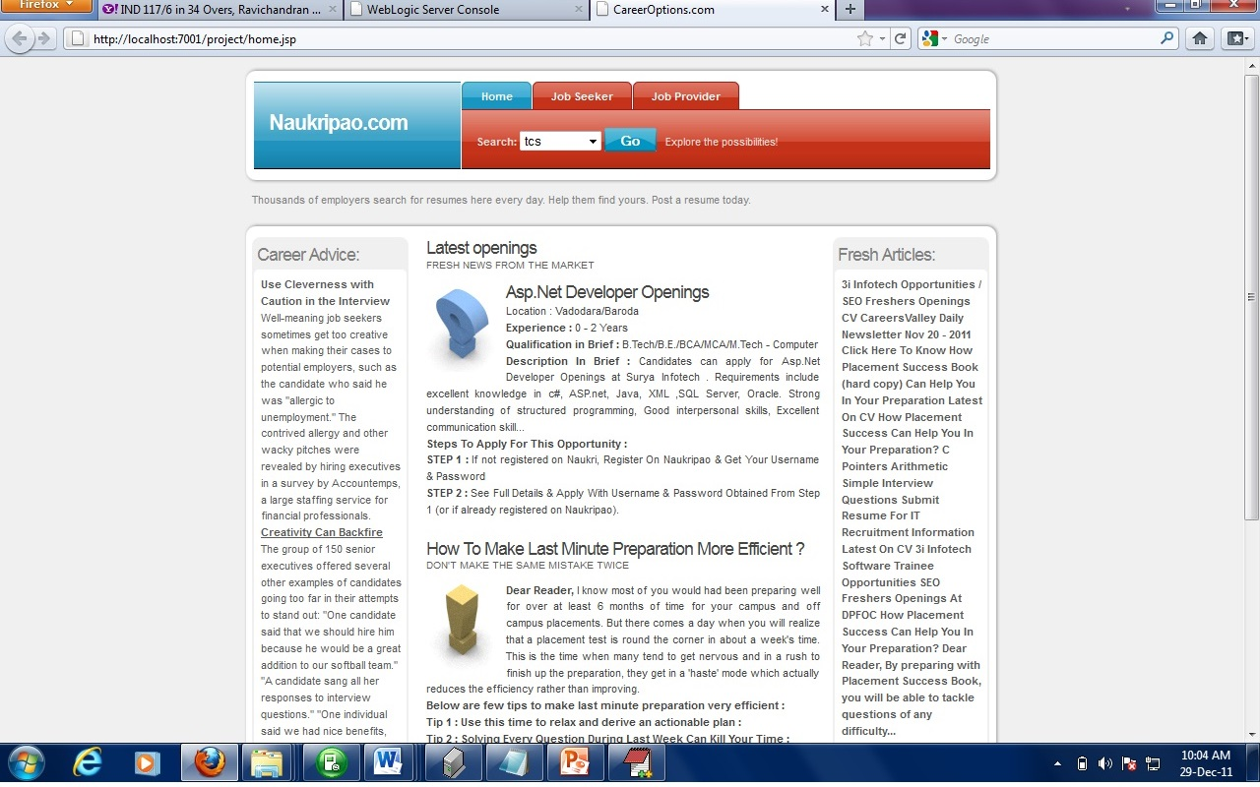
The Home page

Slide 18
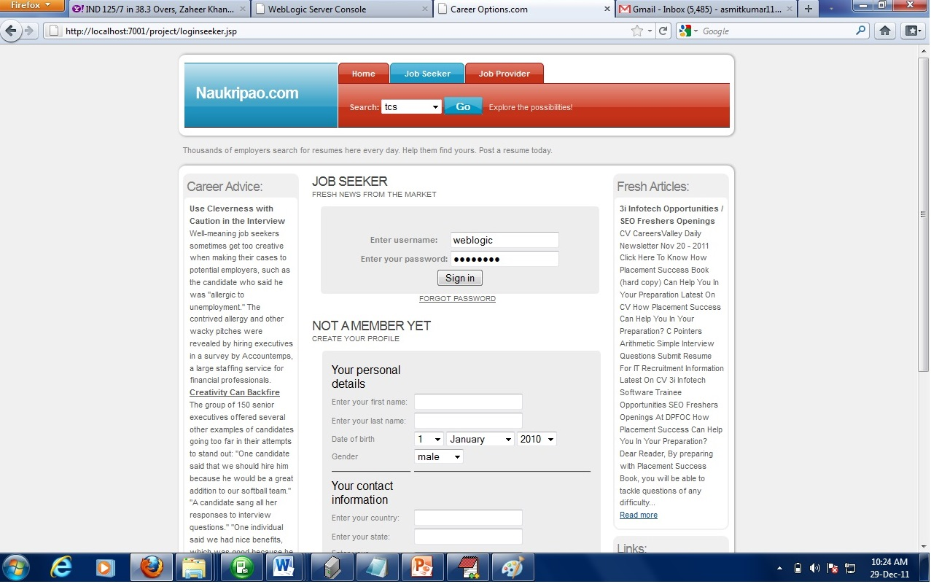
Job Seeker Login and Registration

Slide 19
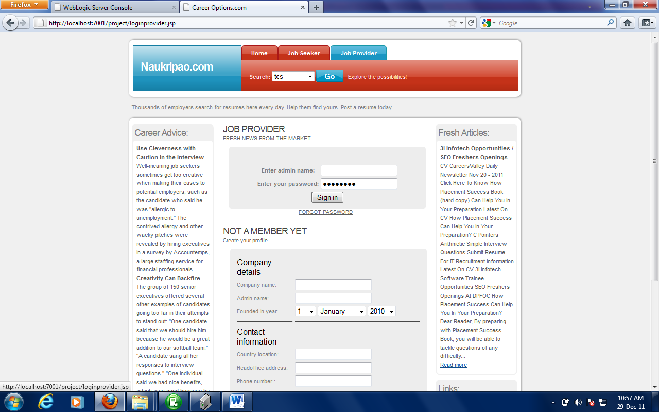
Job Provider Login and Registration

Slide 20
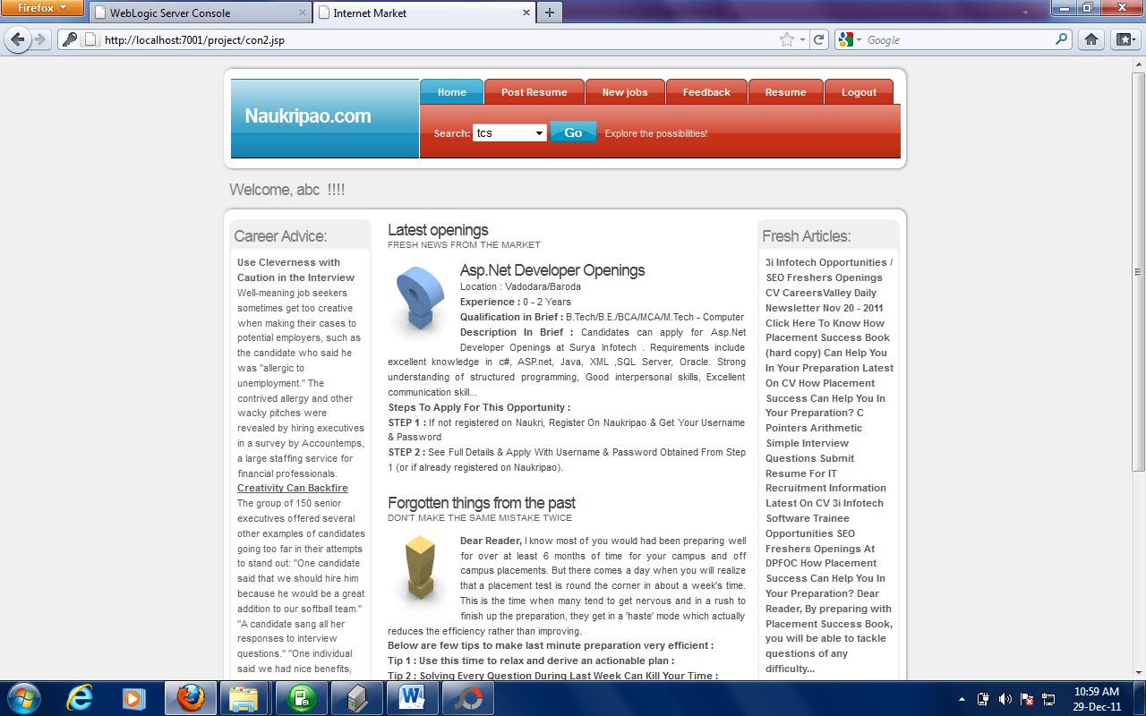
Job Seeker Home page:

Slide 21
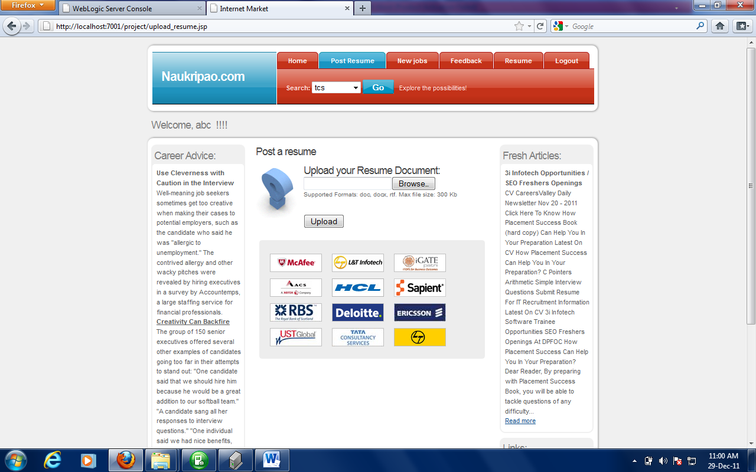
Upload Resume Page

Slide 22
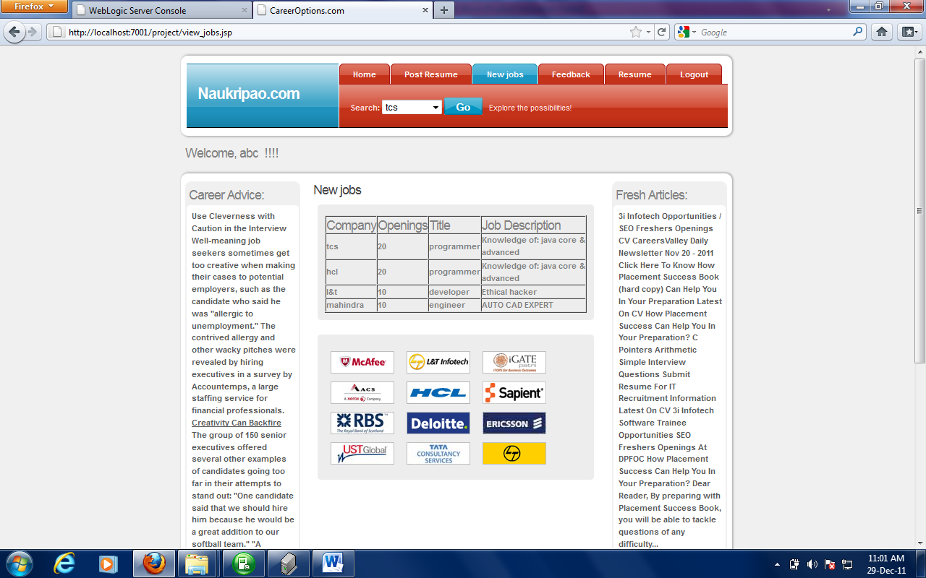
New Jobs Page:

Slide 23
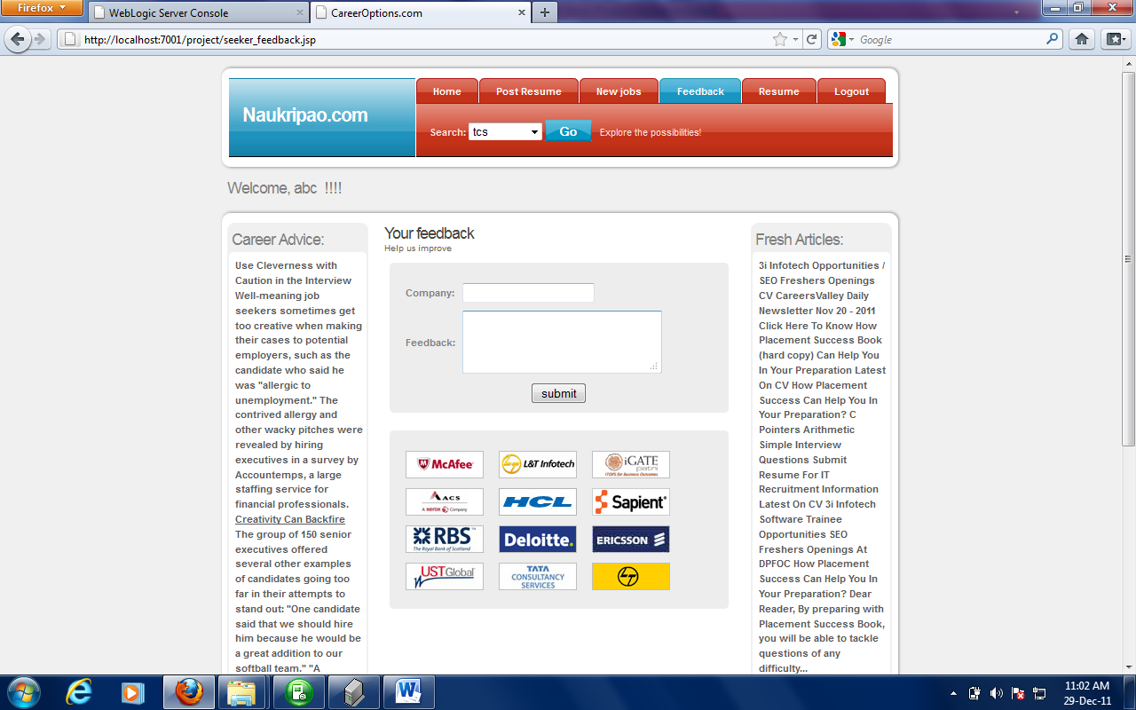
Feedback Page-Job seeker

Slide 24
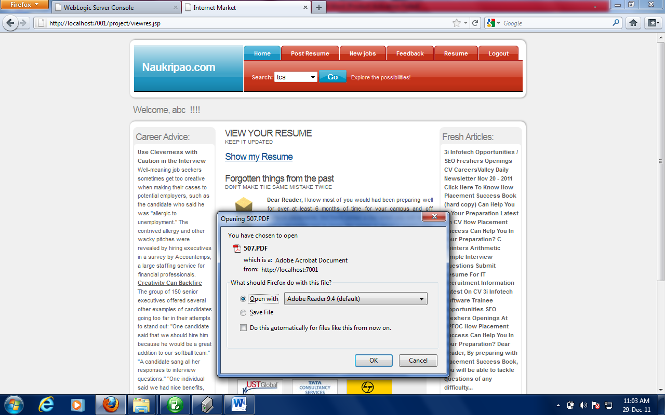
Resume viewer page:

Slide 25
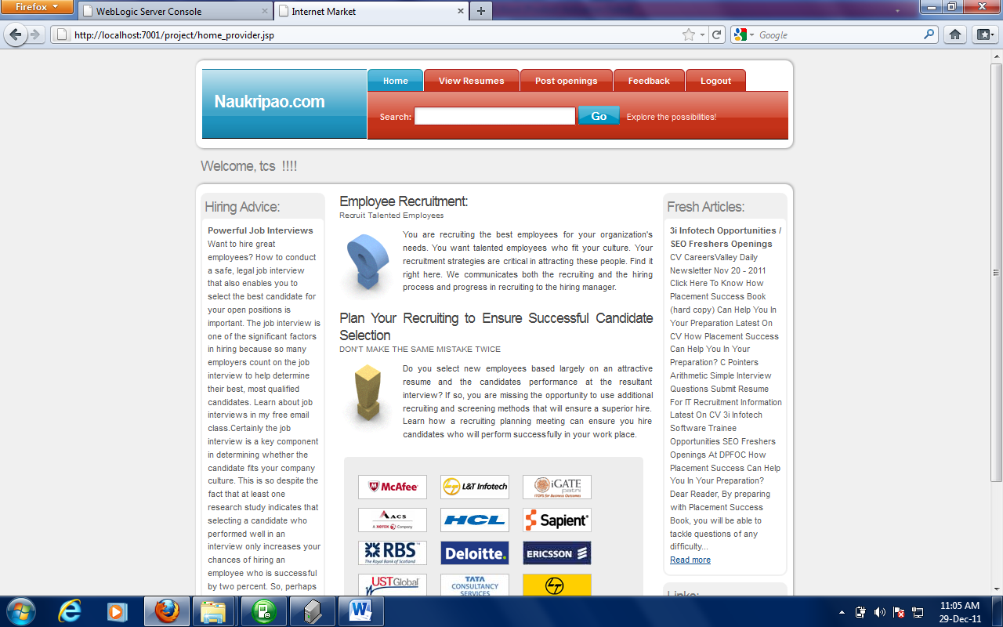
Job Provider home Page:

Slide 26
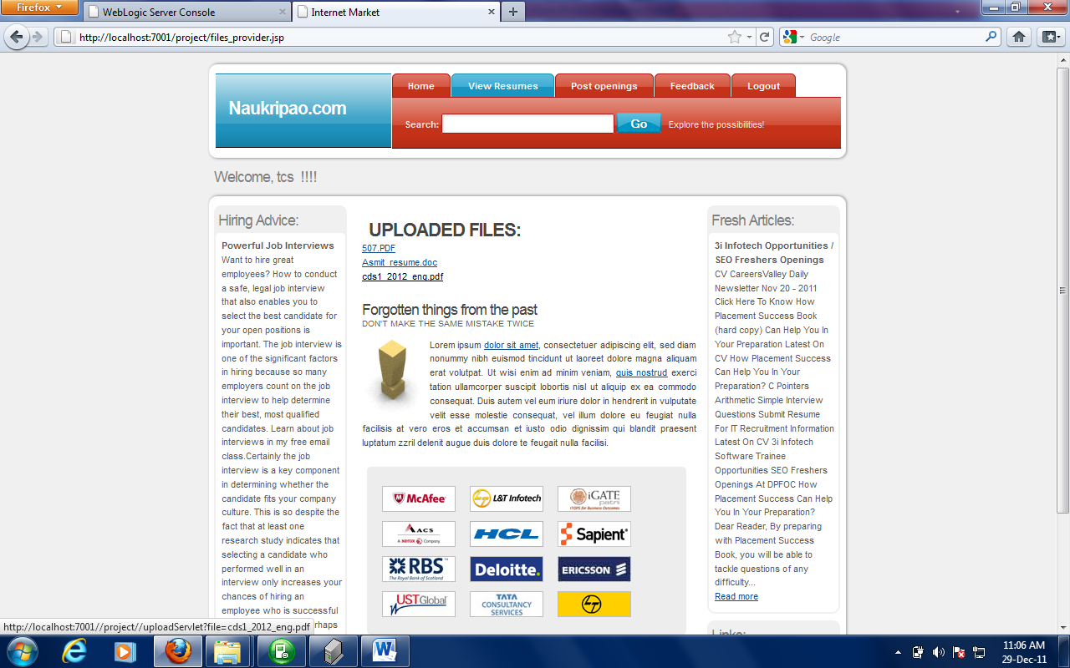
Resume Viewer-Job provider

Slide 27
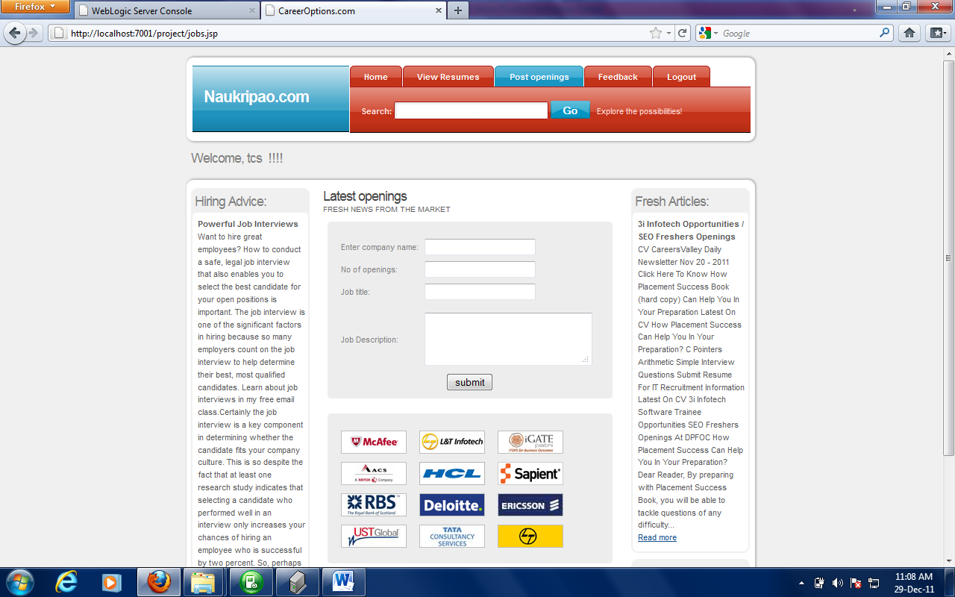
New openings submission page:

Slide 28
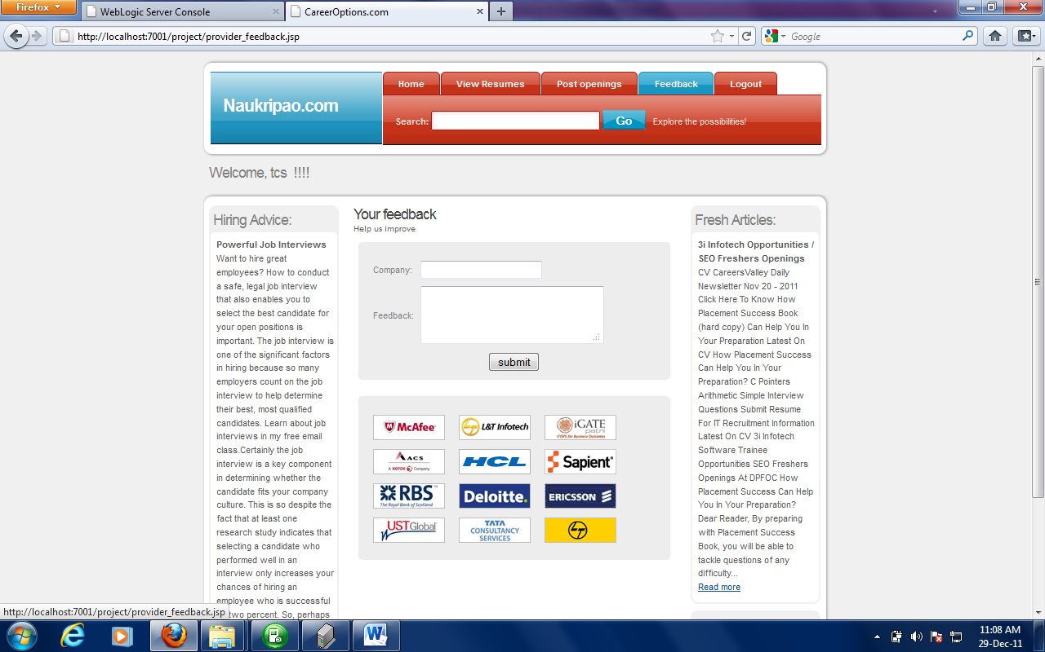
Job provider feedback page:

Slide 29
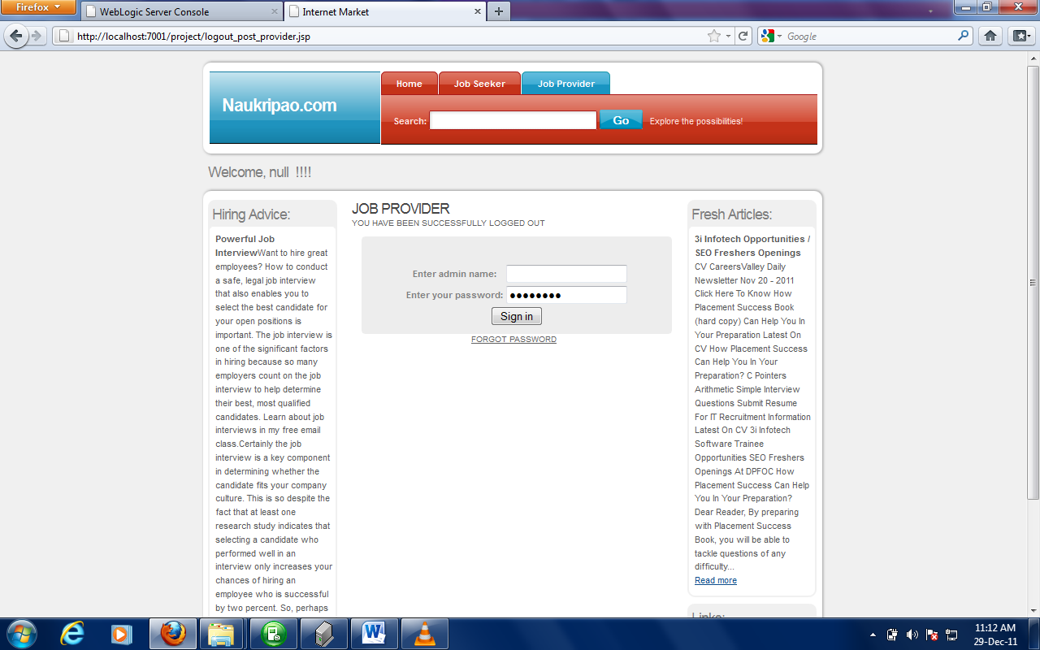
Logout Confirmation page for job provider

Slide 30
Logout Confirmation page for job provider

Slide 31
Thank you

